Slide 1
F-Test in Linear Regression
The F value is the ratio of the mean regression sum of squares divided by the mean error sum of squares. Its value will range from zero to an arbitrarily large number. The value of Prob(F) is the probability that the null hypothesis for the full model is true (i.e., that all of the regression coefficients are zero).
Link: http://facweb.cs.depaul.edu/sjost/csc423/documents/f-test-reg.htm

Slide 2
Interaction Term in Linear Regression
Source: http://www.polsci.ucsb.edu/faculty/glasgow/ps15/dvint.pdf

Slide 3
Factor Analysis (FA)
Why use factor analysis?
Factor analysis is a useful tool for investigating variable relationships for complex concepts such as socioeconomic status, dietary patterns, or psychological scales.
It allows researchers to investigate concepts that are not easily measured directly by collapsing a large number of variables into a few interpretable underlying factors.
What is a factor?
The key concept of factor analysis is that multiple observed variables have similar patterns of responses because they are all associated with a latent (i.e. not directly measured) variable.
For example, people may respond similarly to questions about income, education, and occupation, which are all associated with the latent variable socioeconomic status.
Variables | Factor 1 | Factor 2
Income | 0.65 | 0.11
Education | 0.59 | 0.25
Occupation | 0.48 | 0.19
House value | 0.38 | 0.60
Number of public parks in neighborhood | 0.13 | 0.57
Number of violent crimes per year in neighborhood | 0.23 | 0.55
Source: https://onlinecourses.science.psu.edu/stat505/node/74

Slide 4
Single Decision Tree At a Glance…
Popular learning method for data exploration
Used for both Classification and Regression
Collection of one or more if-then-else statements for the predictors that partition the data
Within the partitions, a model is used to predict the outcome
Decision trees can handle both categorical and numerical data.

Slide 5
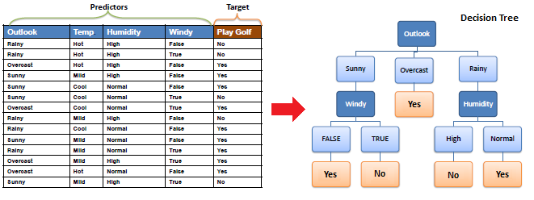
Single Decision Tree: Brief Concept
Decision tree builds classification or regression models using a tree structure. It breaks down a dataset into smaller and smaller subsets while at the same time an associated decision tree is incrementally developed.
The final result is a tree with decision nodes and leaf nodes. A decision node (e.g., Outlook) has two or more branches (e.g., Sunny, Overcast and Rainy). Leaf node (e.g. decision to play : Yes or No) represents a classification or decision. The topmost decision node in a tree which corresponds to the best predictor called root node.
Decision trees can handle both categorical and numerical data.

Slide 6
How do we pick the splitting attribute?
We need to determine the attribute that contributes the most information, for example, If we knew the Outlook was Sunny, its more likely that we would go out and play than just knowing its not humid outside!
The measure we need is termed as the Information Gain for the attribute
Once we know the splitting attribute, we branch the tree in the direction of all the unique values for that attribute. For example, for 3 unique values, a 3 way branch is necessary
?
?
?

Slide 7
Entropy and Information Gain
A decision tree is built top-down from a root node and involves partitioning the data into subsets that contain instances with similar values (homogenous).
Most algorithms uses entropy to calculate the homogeneity of a sample. If the sample is completely homogeneous the entropy is zero and if the sample is an equally divided it has entropy of one.
In simple terms, Entropy or Impurity measures the level of impurity in a group of samples
Very Impure Group
Less Impurity
Minimum Impurity
+ + + + + 0 0 0 0 + + +
0 0 0 0
+ + 0 0 0 0 0 0 0 0
+
0 0 0 0 0
0 0 0
+ and 0 represents two classes that we want to classify

Slide 8
2 Class Case
What is the entropy of a group in which all examples belong to the same class?
Entropy= -1log₂1= 0; Not a good training set
What is the entropy of a group with 50% in either class?
Entropy = -0.5Log₂0.5
Good training set

Slide 9
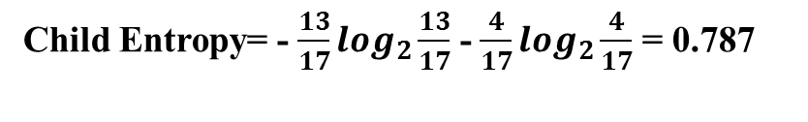
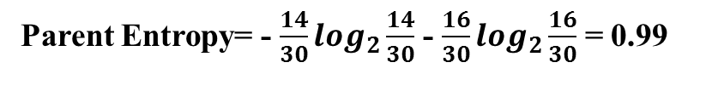

Calculating Information Gain
Information Gain= entropy(parent) –[average entropy(children)]
17 instances
+++++++++++++
0000
Entire population (30 instances)
++++++++++ ++++ 00000
0000000000
0
Child Entropy= - $\frac{13}{17}\log_{2}\frac{13}{17}$ - $\frac{4}{17}\log_{2}\frac{4}{17}$ = 0.787
13 instances
+ 00000000
0000
Parent Entropy= - $\frac{14}{30}\log_{2}\frac{14}{30}$ - $\frac{16}{30}\log_{2}\frac{16}{30}$ = 0.99
Child Entropy= - $\frac{1}{13}\log_{2}\frac{1}{13}$ - $\frac{12}{13}\log_{2}\frac{12}{13}$ = 0.391

Slide 10

Calculating Information Gain
(Weighted) Average Entropy of Children= $\frac{17}{30}$ *(0.787) + $\frac{13}{30}$ *(0.391) = 0.615
Information Gain= 0.996 -0.615 = 0.38 for this split

Slide 11
When to Play Golf?

Slide 12
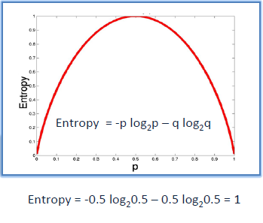
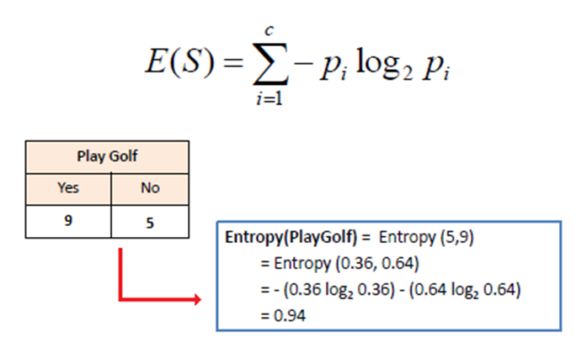
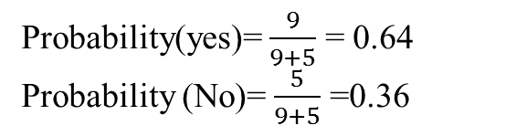
Entropy and Information Gain in our current example
a. Entropy using the frequency table of one attribute:
Probability(yes)= $\frac{9}{9+5}$ = 0.64
Probability (No)= $\frac{5}{9+5}$ =0.36

Slide 13
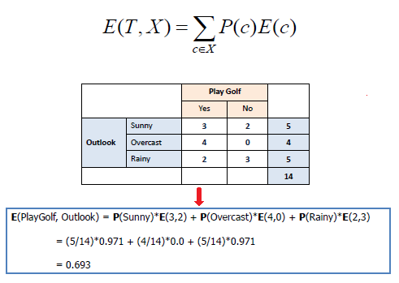
b. Entropy using the frequency table of two attributes (Outlook and Decision to Play Golf):
If Outlook=Sunny, then out of 5 days, golf is played on 3 days. So the associated Entropy(play golf, Outlook=Sunny)=(5/14)*0.971.
Similarly, if Outlook= Over cast or Outlook=Rainy, we can compute entropies as shown below.
Information Gain
The information gain is based on the decrease in entropy after a dataset is split on an attribute. Constructing a decision tree is all about finding attribute that returns the highest information gain (i.e., the most homogeneous branches).

Slide 14
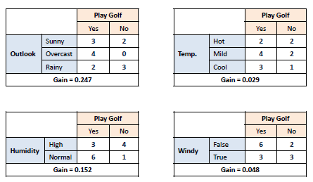
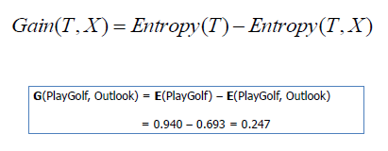
Step 1: Calculate entropy of the target
Entropy (Play Golf) = Entropy (5,9) =Entropy(0.36,0.64)
= - (0.36*log₂0.36)-(0.64*log₂0.64)
=0.94
Step 2: The dataset is then split on the different attributes. The entropy for each branch is calculated. Then it is added proportionally, to get total entropy for the split. The resulting entropy is subtracted from the entropy before the split. The result is the Information Gain, or decrease in entropy.
1
2
3
4
As described, we can split the data in 4 ways based on 4 different attributes (Outlook, Temperature, Humidity and Wind) that we have here.

Slide 15
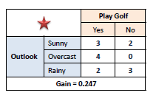
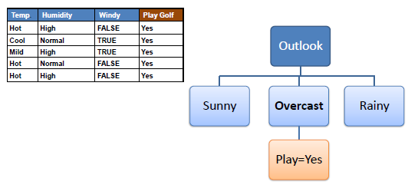
Step 3: Choose attribute with the largest information gain as the decision node.
Step 4a: A branch with entropy of 0 is a leaf node.

Slide 16
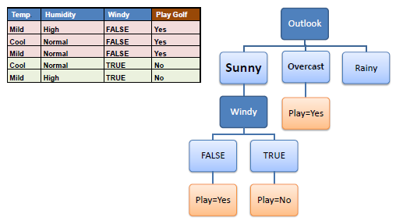
Step 4b: A branch with entropy more than 0 needs further splitting
Step 5: The algorithm is run recursively on the non-leaf branches, until all data is classified

Slide 17
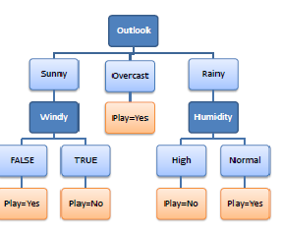
Decision Tree to Decision Rules
R1= IF (Outlook=Sunny) and (Windy=False) THEN Play=Yes;
R2= IF (Outlook=Sunny) and (Windy=True) THEN Play=No;
R3= IF (Outlook=Overcast) THEN Play=Yes;
R4= IF (Outlook=Rainy) and (Humidity=High) THEN Play=No;
R5= IF (Outlook=Sunny) and (Humidity=Normal) THEN Play=Yes
A decision tree can easily be transformed to a set of rules by mapping from the root node to the leaf nodes one by one.

Slide 18
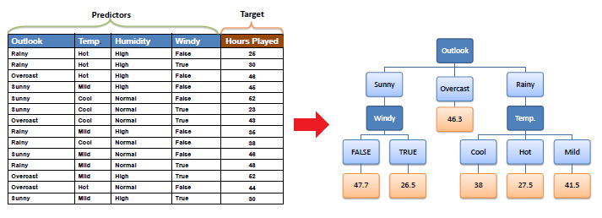
Decision Tree for Regression
Note the difference from classification example, here decision nodes are numeric values instead of classes
A decision node (e.g., Outlook) has two or more branches (e.g., Sunny, Overcast and Rainy), each representing values for the attribute tested. Leaf node (e.g., Hours Played) represents a decision on the numerical target.

Slide 19
Decision Tree for Regression
The core algorithm for building decision trees called ID3 by J. R. Quinlan which employs a top-down, greedy search through the space of possible branches with no backtracking. The ID3 algorithm can be used to construct a decision tree for regression by replacing Information Gain with Standard Deviation Reduction.

Slide 20
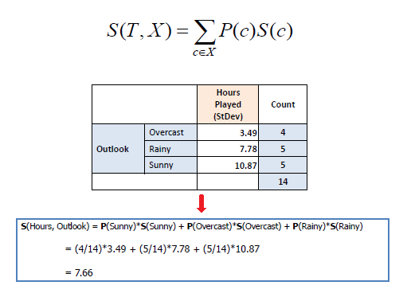
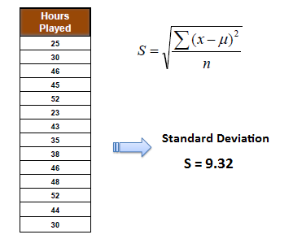
Decision Tree for Regression
2. Standard deviation for two attributes:
1. Standard deviation for one attribute:

Slide 21
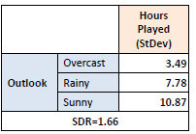

Decision Tree for Regression: The Algorithm
The main goal here is to reduce standard deviation. Remember, in classification, our aim was to reduce entropy at the decision node.
The aim is to find attribute that returns the highest standard deviation reduction (i.e., the most homogeneous branches). So the algorithm runs much like what we have seen in classification case.
Step 1: The standard deviation of the target is calculated. Here, standard deviation (Hours Played)=9.32.
Step 2: The standard deviation of the target is calculated.
Step 3: The attribute with the largest standard deviation reduction is chosen for the decision node. The highest reduction is achieved by splitting data by outlook as shown above.

Slide 22
Decision Tree for Regression: The Algorithm
Step 4: Dataset is divided based on the values of the selected attribute. A branch with standard deviation more than 0 needs further splitting. Usually we provide with some stopping criteria i.e. stop growing the tree if standard deviation for the branch becomes smaller than a certain fraction of overall standard deviation of the data set or too few instances remain in the branch.
The process is run recursively on the non-leaf branches, until all data is processed. When the number of instances is more than one at a leaf node we calculate the average as the final value for the target.

Slide 23
Important Decision Tree Algorithms
ID3, or Iternative Dichotomizer, was the first of three Decision Tree implementations developed by Ross Quinlan (Quinlan, J. R. 1986. Induction of Decision Trees. Mach. Learn. 1, 1 (Mar. 1986), 81-106.)
C4.5, Quinlan's next iteration. The new features (versus ID3) are: (i) accepts both continuous and discrete features; (ii) handles incomplete data points; (iii) solves over-fitting problem by (very clever) bottom-up technique usually known as "pruning"; and (iv) different weights can be applied the features that comprise the training data.
CART, or Classification And Regression Trees : the CART implementation is very similar to C4.5; the one difference is that CART constructs the tree based on a numerical splitting criterion recursively applied to the data, whereas C4.5 includes the intermediate step of constructing *rule set*s.
Useful R Packages to run decision tree: CART, rpart, party, tree. You can find documentation of these packages at: www.rdocumentation.org.

Slide 24
Advantages of Single Decision Tree
Handles “Mixed” type of data
Robust to outliers in input space
Computational Scalability (Large N)
Interpretability (White Box)
Disadvantages of Single Decision Tree
Low Prediction Accuracy
High Variance
So the rise of “Ensemble” methods to keep the advantages while increasing accuracy

Slide 25
Introduction to Machine Learning Ensembles
In order to increase predictive power, instead of using a single decision tree or learning one model, a collection of decision trees or several models are used and final result/decision is done by aggregating them. which is known as “Ensemble Method” in Machine Learning.
Popular Ensemble methods are: Bagging, Boosting & Random Forest.
However, the basic decision making process remains the same by using Entropy and Information gain for classification purpose.
Minimization of Error Variance for Regression Purpose

Slide 26
Random Forest : At a Glance
Collection of Unpruned decision trees
Consists of a rule to combine the outcomes of the decision
Goal is to improve prediction accuracy
Randomness is introduced in two ways:
Bootstrapping or Sampling with replacement: each tree is built on bootstrap sample of training data
Random Selection of Predictor variables used for splitting

Slide 27
Random Forest: First randomization through bagging
Random forest: first randomization through bagging
Bagging = bootstrap aggregation (Breiman 1996)
Bootstrap sample = create new training sets by random sampling the
given one N′≤N times with replacement
Bootstrap aggregation … parallel combination of learners,
independently trained on distinct bootstrap samples
Final prediction is the mean prediction (regression) or class with
maximum votes (classification).
Using squared error loss, bagging alone decreases test error by
lowering prediction variance, while leaving bias unchanged.

Slide 28
Bias-Variance Trade-Off
Typically one wants to choose a model that both accurately captures the regularities in its training data (Low Bias), but also generalizes well to unseen data (Low Variance). Unfortunately, it is typically impossible to do both simultaneously. Usually, a low bias (e.g. fitting a polynomial regression instead of linear regression) will lead to high variance in new data i.e. it will not generalize it well. This is known as Bias-Variance Trade-off in Machine Learning.

Slide 29
Bias-Variance Tradeoff
Hastie, Tibshirani, Friedman “Elements of Statistical Learning” 2001

Slide 30
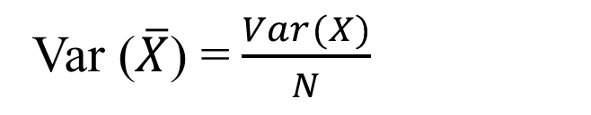
Reducing Variance through Bagging
Averaging reduces variance without increasing bias
Var ($\overline{X}$) =$\frac{Var(X)}{N}$
Average models to reduce model variance
That’s exactly what Bagging does.
However, models are correlated, so reduction is smaller than 1/N.
This is taken care of in next randomization through subset of predictor selection

Slide 31
Random Forest: Second Randomization through predictor subset
Bagging alone utilizes the same full set of predictors to
determine each split.
However random forest applies another judicious injection
of randomness: namely by selecting a random subset of the
predictors for each split (Breiman 2001)
Number of predictors to try at each split is known as mtry.
While this becomes new parameter, typically
(classification) or (regression) works quite well.
RF is not overly sensitive to mtry
Bagging is a special case of random forest where mtry=k

Slide 32
Random Forest: Second Randomization
Overall the additional randomness:
further reduces variance even on smaller sample set
sizes, improving accuracy
however significantly lowering predictor set at each node
might lower accuracy, particularly if there are few good
predictors among many non-informative “predictors”
Subset of predictors much faster to search than all
Predictors
Decorelates the trees

Slide 33
Random Forest Algorithm
Splits are chosen according to a purity measure:
e.g. squared error (regression), Gini index or Information Gain (classification)
How to select Ntrees?
Build trees until the error no longer decreases
How to select mtry ?
Try the recommended defaults, half of them and
twice them and pick the best

Slide 34
Tuning Parameters of Random Forest
Parameter | Description | Ideal Value
Mtry | Number of randomly selected predictors to make the split | Classification: Sqrt(P) Regression: 1/3rd of P
Ntree | Number of trees built | Usually 500 (default in random forest package in R)
By choosing a random number of variables at each split, this algorithm de-correlates the trees.

Slide 35
Random Forest Algorithm: Considerations
RF retains many benefits of decision trees …
continuous and categorical predictors, and problems where k>>N
while achieving results that decision trees cannot:
RF does not require tree pruning to generalize
Over variety of problem domains, RF improves prediction
accuracy compared to single trees:

Slide 36
Random Forest Algorithm
Let Ntrees be the number of trees to build
for each of Ntrees iterations
Select a new bootstrap sample from training set
2. Grow an un-pruned tree on this bootstrap.
3. At each internal node, randomly select mtry predictors and
determine the best split using only these predictors.
4. Do not perform cost complexity pruning. Save tree as is,
along side those built thus far.
Output overall prediction as the average response (regression) or majority vote (classification) from all individually trained trees

Slide 37
Model Validation
We do not need to create a training & test/cross-validation data set in Random Forest
Each tree is build with 63% of observation
Rest 37% works as hold out sample for each tree
OOB or Out of Bag error works as the cross-validation error/accuracy of random forest model
Advantages: accurate classifier with out much work, runs efficiently on large data set, inherently parallel so can be implemented in cluster computing (Big Data)

Slide 38
Model Validation Metrics
Confusion Matrix
What percent of your predictions were correct? You answer: the "accuracy" was (9,760+60) out of 10,000 = 98.2%
Precision and Recall
 | Predicted Negative (or 0) | Predicted Positive(or 1)
Negative (or 0) cases | TN:9760 | FP:140
Positive (or 1) Cases | FN:40 | TP:60

Slide 39
Precision & Recall
What is Precision? What is Recall?
What percent of the positive cases did you catch? You answer: the "recall" was 60 out of 100 = 60%
What percent of positive predictions were correct? You answer: the "precision" was 60 out of 200 = 30%
 | Predicted Negative (or 0) | Predicted Positive(or 1)
Negative (or 0) cases | TN:9760 | FP:140
Positive (or 1) Cases | FN:40 | TP:60

Slide 40
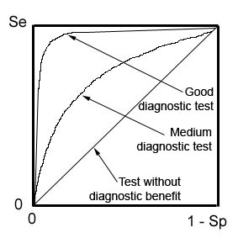
ROC Curve
Receiver Operating Characteristic curve (or ROC curve) is a plot of the true positive rate against the false positive rate and illustrates the performance of a binary classifier system
An ROC curve demonstrates several things:
The closer the curve follows the left-hand border and then the top border of the ROC space, the more accurate the test.
The closer the curve comes to the 45-degree diagonal of the ROC space, the less accurate the test.
The area under the curve is a measure of accuracy.
Se = Sensitivity = True positive
Sp = Specificity
1-Sp = False positive

Slide 41
Problem of Class Imbalance
Many times, one of the class may be much higher in number than the other
Solution: Resampling. Under sample the overrepresented class

Slide 42
How to avoid over fitting in decision trees?
Overfitting is a significant practical difficulty for decision tree models and many other predictive models. Overfitting happens when the learning algorithm continues to develop hypotheses that reduce training set error at the cost of an increased test set error. There are several approaches to avoiding over fitting in building decision trees.
Pre-pruning that stop growing the tree earlier, before it perfectly classifies the training set.
Post-pruning that allows the tree to perfectly classify the training set, and then post prune the tree.

Slide 43
Overfitting
Practically, the second approach of post-pruning overfit trees is more successful because it is not easy to precisely estimate when to stop growing the tree.
The important step of tree pruning is to define a criterion be used to determine the correct final tree size using one of the following methods:
Use a distinct dataset from the training set (called validation set), to evaluate the effect of post-pruning nodes from the tree. Build the tree by using the training set, then apply a statistical test to estimate whether pruning or expanding a particular node is likely to produce an improvement beyond the training set. Error estimation Significance testing (e.g., Chi-square test) Minimum Description Length principle : Use an explicit measure of the complexity for encoding the training set and the decision tree, stopping growth of the tree when this encoding size (size(tree) + size(misclassifications(tree)) is minimized. The first method is the most common approach. In this approach, the available data are separated into two sets of examples: a training set, which is used to build the decision tree, and a validation set, which is used to evaluate the impact of pruning the tree.

Slide 44
Over fitting in Random Forest
To avoid over-fitting in random forest, we need to optimize a tuning parameter that governs the number of features that are randomly chosen to grow each tree from the bootstrapped data.
Think of Post-pruning in decision trees.
Typically, you do this via k-fold cross-validation, where k∈{5,10}, and choose the tuning parameter that minimizes test sample prediction error.

Slide 45
Random Forest: Comparison with other classifiers
Comparisons: random forest vs SVMs, neural networks
Random forests have about or higher same accuracy as SVMs and neural networks, however:
RF is more interpretable
Feature importance can be estimated during training for little additional
computation
Plotting of sample proximities
Visualization of output decision trees
RF readily handles larger numbers of predictors.
Faster to train Has fewer parameters
Cross validation is unnecessary : It generates an internal unbiased estimate of the generalization error (test error) as the forest building progresses

Slide 46
Random Forest: Comparison with other classifiers
Random Forest and Boosting
Main similarities:
Both derive many benefits from ensembling, with few
disadvantages
Both can be applied to ensembling decision trees.
Main differences:
Boosting performs an exhaustive search for best predictor to split on; RF searches only a small subset
Boosting grows trees in series, with later trees dependent on the results of previous trees; RF grows trees in parallel independently of one another.

Slide 47
Random Forest: Comparison with other classifiers
Random Forest and Boosting
Which one to use and when…
RF has about the same accuracy as boosting for classification, For continuous response, boosting appears to outperform RF
Boosting may be more difficult to model and requires more attention to parameter tuning than RF.
On very large training sets, boosting can become slow with many predictors, while RF which selects only a subset of predictors for each split, can handle significantly larger problems before slowing.
RF will not overfit the data. Boosting can overfit (though means can be implemented to lower the risk of it).
If parallel hardware is available, (e.g. multiple cores), RF embarrassingly parallel with out the need for shared memory as all trees are independent

Slide 48
Random Forest: In a Nutshell
RF is fast to build. Even faster to predict!
Practically speaking, not requiring cross-validation alone for model selection
significantly speeds training by 10x-100x or more.
Fully parallelizable … to go even faster!
Automatic predictor selection from large # of candidates
RF can be used for feature selection alone; or to streamlining other, slower learners
Resistance to over training
Ability to handle data without preprocessing
data does not need to be rescaled, transformed, or modified
resistant to outliers
Cluster identification
can be used to generate tree-based clusters through sample proximity
Interpretability
Predictor importance, sample proximity and tree structure offer insights into data

Slide 49
Feature Selection &Variable Importance
Random Forest also offers Feature Selection and implicit ranking of predictor variables.
Random forest consists of a number of decision trees. Every node in the decision trees is a condition on a single feature, designed to split the dataset into two so that similar response values end up in the same set. The measure based on which the (locally) optimal condition is chosen is called impurity. For classification, it is typically either Gini impurity or information gain/entropy and for regression trees it is variance. Thus when training a tree, it can be computed how much each feature decreases the weighted impurity in a tree. For a forest, the impurity decrease from each feature can be averaged and the features are ranked according to this measure.

Slide 50
Variable Importance
Measures of Variable Importance: Mean Decrease Gini and Mean Decrease Accuracy
Mean Decrease Gini: Gini is defined as “impurity” when used in describing a society's distribution of income or a measure of “node impurity” in tree based classification. A low Gini or higher decrease in Gini means that a particular predictor variable plays a greater role in partitioning the data into the defined classes.
Mean Decrease Accuracy : This measure is very R specific. It represents inclusion of this particular variable in model reduces classification error.

Slide 51
Boruta Algorithm
Boruta Algorithm -This algorithm is similar to random forest, only more randomness to the system is added. The essential idea is to make a randomized copy of the system, merge the copy with the original and build the classifier for this extended system. To asses importance of the variable in the original system we compare it with that of the randomised variables. Only variables for whose importance is higher than that of the randomised variables are considered important.
More information on this algorithm is available at: Kursa,M.B. Boruta –A System for Feature Selection, Fundamenta Informaticae 101 (2010) 271–285
>attStats(Boruta.fit)
This R syntax produces Z Scores of each individual predictor variables and often useful to gain insight

Slide 52
Feature Selection Using VarSELRF Package
R package VarSELRF includes backward selection algorithm with Random Forest.
Initially, it runs a Random Forest with all the variables and computes Out of Bag (OOB) error.
It then sequentially reduces the number of variables & computes OOB in each step.
The set of variables with least OOB is chosen.
This is essentially similar to Backward Elimination in Regression for subset selection.
#FEATURE SELECTION USING VarSELRF#
library(varSelRF)
set.seed(1)
rf.vs1 = varSelRF(data[,1:18], data$Hired, vars.drop.frac = 0.2)
rf.vs1
Above R syntax will provide a list of predictor variables that are most important for classification purpose, we will see this in actual R environment

Slide 53
Business Case: Solve a business case using Random Forest
A big bank wants to detect money laundering threat in credit card transactions
This bank has transaction related information of its credit card users
it also has a small subset of data with money laundering alert (i.e. if an alert has been issued then this indicator is 1, 0 otherwise)
This bank now aims to create a process to generate alert on new transactions
We will work on this in R set up. This case will provide you with some insight how this technique is used in actual analytics industry.

Slide 54
Random Forest for Regression Purpose
So far, we have looked at Random Forest as a Classifier (Majority of times it is used as a classifier). Now we will work in R on a regression problem.
Analysis of Wine Quality Data
Objective of the Analysis
Prediction of Quality ranking from the chemical properties of the wines
A predictive model developed on this data is expected to provide guidance to vineyards regarding quality and price expected on their produce. We will use Random Forest for this purpose.
Data set is available from https://archive.ics.uci.edu/ml/datasets/Wine
It includes both categorical & numerical variables and consist of around 1600records.
We will work on this in R now.

Slide 55
Useful Resources
Random Forest:
Website maintained by Leo Breiman:
https://www.stat.berkeley.edu/~breiman/RandomForests/cc_home.htm
Kaggle Tutorial: https://www.kaggle.com/c/bike-sharing-demand/forums/t/11525/tutorial-0-433-score-with-randomforest-in-r
https://www.kaggle.com/c/titanic/details/getting-started-with-random-forests
R-Blogger: http://www.r-bloggers.com/a-brief-tour-of-the-trees-and-forests/
Python Sci-Kit Learn (SK Learn):
http://scikit-learn.org/stable/modules/ensemble.html
Revolution R/ScaleR:
http://blog.revolutionanalytics.com/2014/01/a-first-look-at-rxdforest.html

Slide 56
Useful Resources
Apache Spark MLLIB
http://spark.apache.org/mllib/
Feature Selection in R:
Boruta Package: http://www.jstatsoft.org/v36/i11/paper
VarSelRF Package: https://cran.r-project.org/web/packages/varSelRF/varSelRF.pdf
Caret Package: http://caret.r-forge.r-project.org/
Roadmap to choose different type of classifier: http://www.quora.com/What-are-the-advantages-of-different-classification-algorithms
Cheat Sheet: http://scikit-learn.org/stable/tutorial/machine_learning_map/
Book on Statistical Learning (FREE!!!): http://web.stanford.edu/~hastie/local.ftp/Springer/OLD/ESLII_print4.pdf

